Slide 1
UNIT-1 CSS
-Ms. Shreya

Slide 2
The market place for Vernabilities
Error 404 Hacking Digital India part I Chase
Control Hijacking
Buffer Overflow attacks
Integer Overflow attacks
Format String attacks
Defence against Control hijacking

Slide 3
Topics to be discussed in unit-1
What is Computer System Security
Components of computer security
CIA Traid
Computer security threats
Real life goals of computer security
Cyber sample attacks
Active & passive Attacks

Slide 4
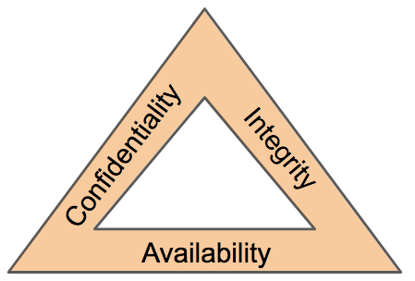
What is Computer System Security
Three basic security concepts important to information on the internet are
-Confidentiality
-Integrity
-Availability.

Slide 5
Sample Attacks
In computer and computer networks an attack is any attempt to destroy, expose, alter, disable, steal or gain unauthorized access to or make unauthorized use of an asset. A computer attack may be defined as actions directed against computer systems to disrupt equipment operations, change processing control, or corrupt stored data.
Different attack methods target different vulnerabilities and involve different types of weapons, and several may be within the current capabilities of some terrorist groups.
"Passive" when a network intruder intercepts data traveling through the network, and "Active" in which an intruder initiates commands to disrupt the network's normal operation

Slide 6
Active and Passive attacks in Information Security
Active Attacks
Passive Attacks

Slide 7
Active Attacks
Active attacks:
An Active attack attempts to alter system resources or effect their operations. Active attack involve some modification of the data stream or creation of false statement.
Passive attacks:
Passive attack attempts to learn or make use of information from the system but does not affect system resources. Passive Attacks are in the nature of eavesdropping on or monitoring of transmission. The goal of the opponent is to obtain information is being transmitted.

Slide 8
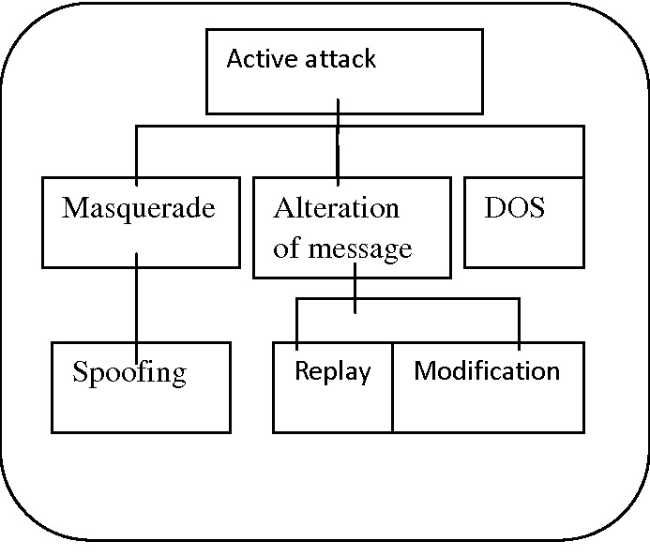
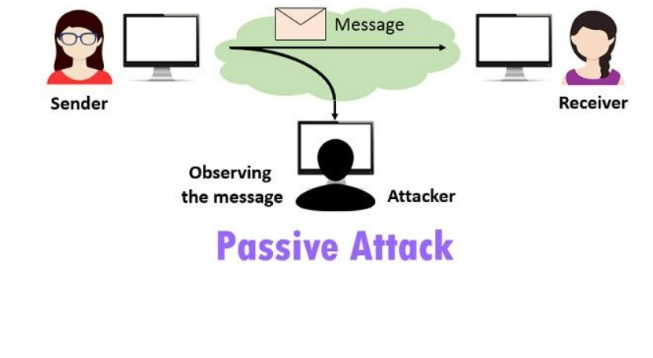
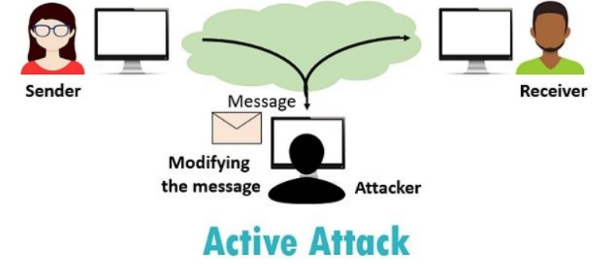
Types of attacks are as following:

Slide 9
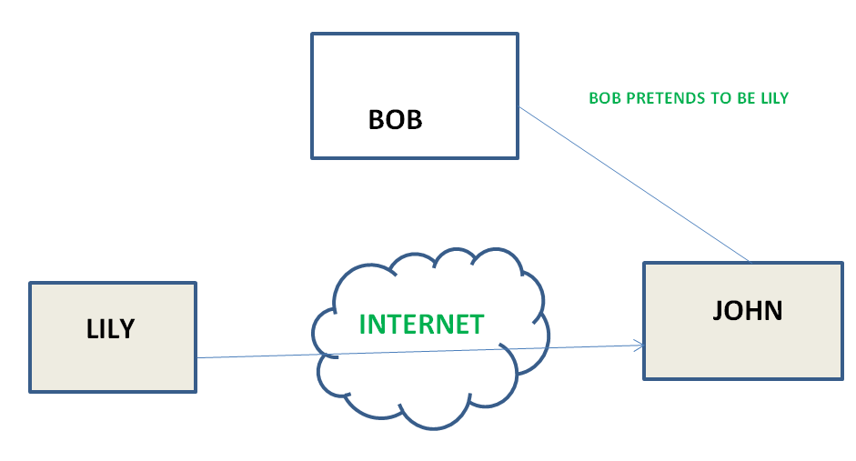
1. Masquerade
Masquerade attack takes place when one entity pretends to be different entity. A Masquerade attack involves one of the other form of active attacks.

Slide 10
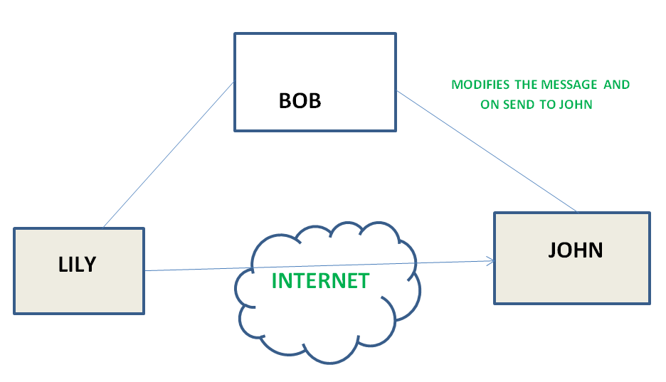
2. Modification of messages
It means that some portion of a message is altered or that message is delayed or reordered to produce an unauthorised effect. For example, a message meaning “Allow JOHN to read confidential file X” is modified as “Allow Smith to read confidential file X”.

Slide 11
3. Repudiation
This attack is done by either sender or receiver. The sender or receiver can deny later that he/she has send or receive a message. For example, customer ask his Bank “To transfer an amount to someone” and later on the sender(customer) deny that he had made such a request. This is repudiation.

Slide 12
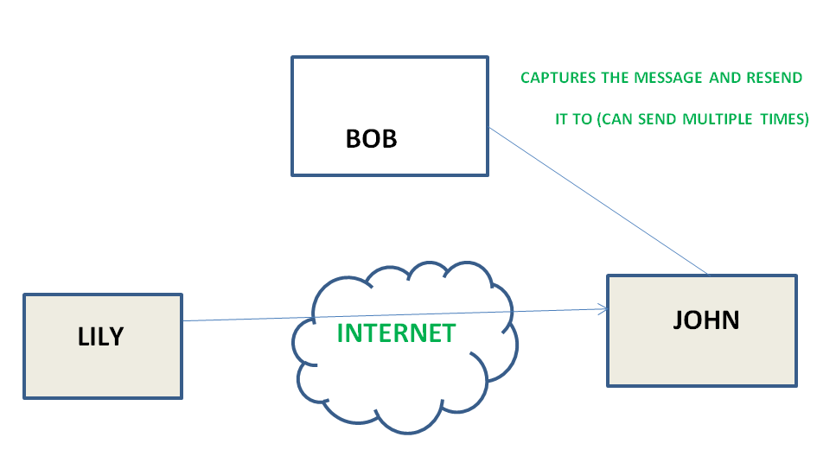
4.Replay
It involves the passive capture of a message and its subsequent the transmission to produce an authorized effect.

Slide 13
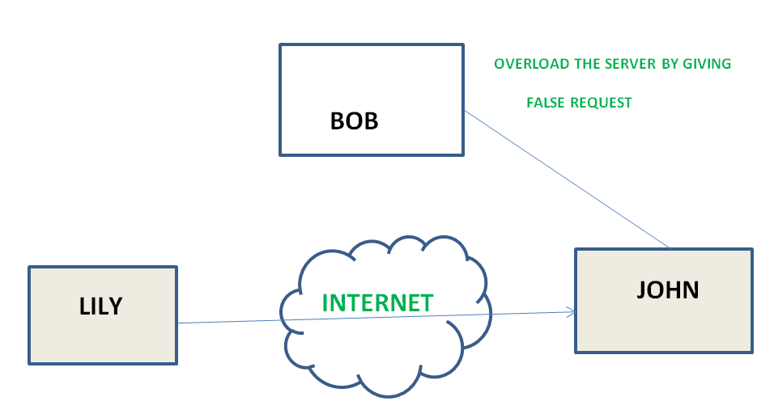
5.Denial of Service –
It prevents normal use of communication facilities. This attack may have a specific target. For example, an entity may suppress all messages directed to a particular destination. Another form of service denial is the disruption of an entire network wither by disabling the network or by overloading it by messages so as to degrade performance.

Slide 14
Passive attacks
Passive attack attempts to learn or make use of information from the system but does not affect system resources. Passive Attacks are in the nature of eavesdropping on or monitoring of transmission. The goal of the opponent is to obtain information is being transmitted.

Slide 15
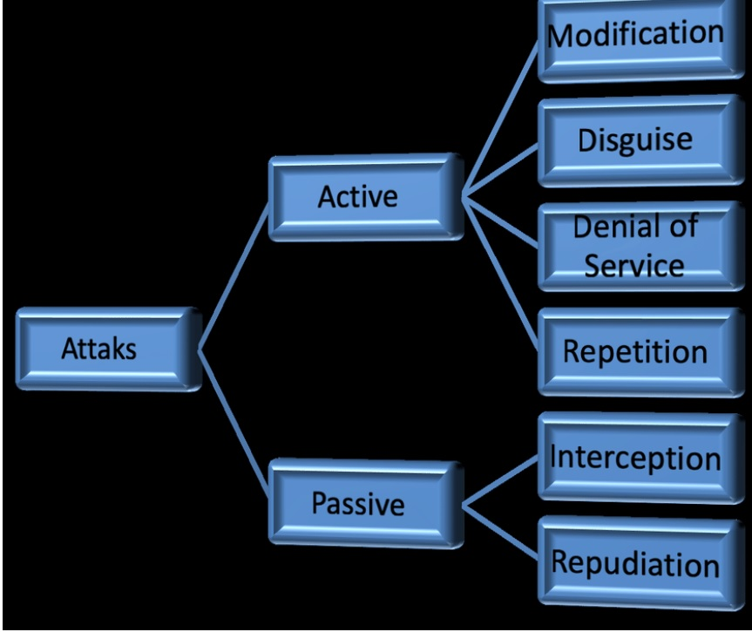
Types of passive attacks

Slide 16
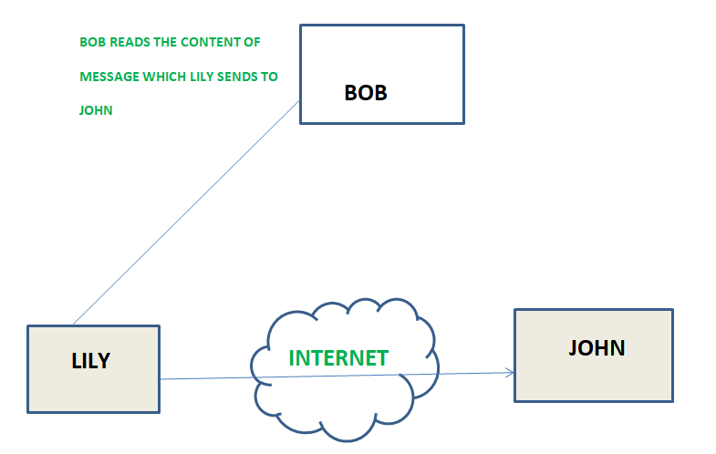
1.The release of message content
Telephonic conversation, an electronic mail message or a transferred file may contain sensitive or confidential information. We would like to prevent an opponent from learning the contents of these transmission.

Slide 17
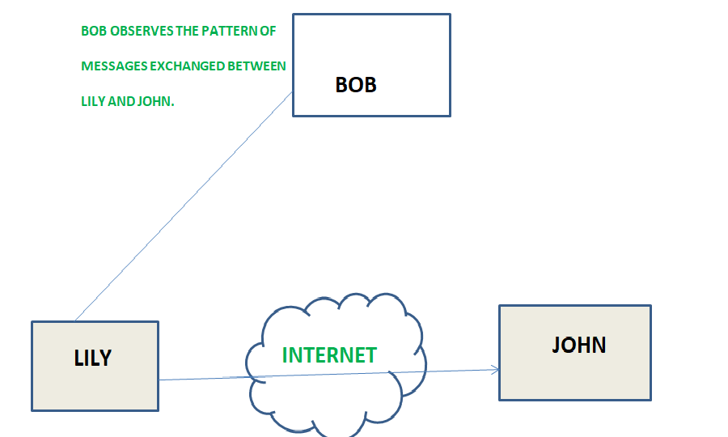
2.Traffic analysis
Suppose that we had a way of masking (encryption) of information, so that the attacker even if captured the message could not extract any information from the message.
The opponent could determine the location and identity of communicating host and could observe the frequency and length of messages being exchanged. This information might be useful in guessing the nature of the communication that was taking place.

Slide 18
The Marketplace for vulnerabilities
Vulnerability is a cyber-security term that refers to a flaw in a system that can leave it open to attack.
Where you can buy vulnerability information and exploits or the product of hacking. Example: credit cards information like: user name, date of birth, date of expire etc.
Unauthenticated protocols. ...
Outdated hardware. ...
Weak user authentication. ...
Weak file integrity checks. ...
Vulnerable Windows operating systems. ...
Undocumented third-party relationships.

Slide 19
The Marketplace for vulnerabilities
By finding security bugs, you can make money. There are three ways to make money from bugs.
1. Bug bounty programs (white hat hackers: doing for good) if anyone of you found any vulnerability in one of their products and if you reported then depending on the vulnerability and its risk that it possesses you will get various s of money:
Example:
• Google vulnerability reward program: up to 100K $
• Microsoft Bounty Program: up to 100K $
• Mozilla bug Bounty Program: 500$ - 3000$
• Pwn2Own competition: 15K $

Slide 20
The Marketplace for vulnerabilities
2. Some services are there that collects vulnerability information and might pay, they are also for good purposes. They would inform to the company so that the patch can be released.
Example:
ZDI, iDefense: 2K – 25K $
3. Black market (bad one), it is where you go and sell vulnerability that you have found.
Example:
Zero-day attack

Slide 21
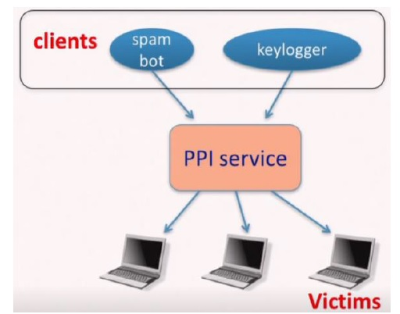
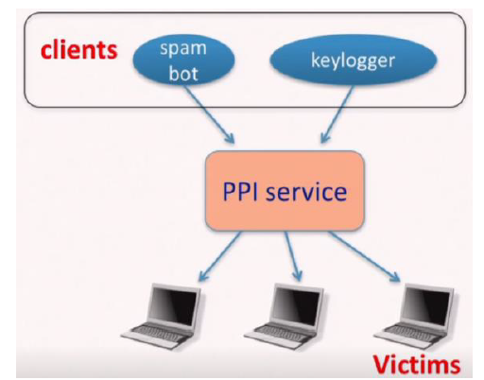
The Marketplace for vulnerabilities
4. Botnet services: people who owns botnets could also use botnets for Pay-per-install (PPI) services. They will advertise that if you want any particular exploit/pay roll to be installed in some other people’s machines, they can do it. And if you can somehow install that exploit in those people’s machine and you can bring information to yourself
for example: keylogger etc.
PPI operation:
1. Own victim’s machine
2. Download and install client’s code
3. Charge client

Slide 22
ERROR 404 HACKING DIGITAL INDIA PART 1 CHASE
Moblie attacks (Through .apk files etc)
By creating a kind of Trojan file, for example: An android.apk file. This is the .apk file that will be distributed all over the internet. And a person whosoever downloads this file, their phone will be hacked easily. They are always bound by some games like Candy Crush, Mini Militia and Clash of Clans etc. You may never know, but that file may contain a backdoor in itself. Your all details can be accessed without your knowledge like photos, call logs, messages etc. so it’s a kind of spy. So, we can access everything that’s there in your phone. There is an option for recording from the mic and after hacking attacker can listen to what you speak.
It is like a crypto-locker. It will not harm your computer, but it will encrypt everything inside your computer. And if it is encrypted, it will ask for a decryption password and to decrypt, you need a key. And that key will only be generated only when you pay a certain amount of money into a Bitcoin (virtual money) address. So that is why it is called Ransomware. More number of things you connect to the internet, greater will be the vulnerability. Today, absolute security is virtually non-existent.

Slide 23
ERROR 404 HACKING DIGITAL INDIA PART 1 CHASE
2. Web application attacks: (Phishing etc)
Hackers can make phishing pages (duplicate pages) for different websites, which asks for a login and other details. The hackers just need a medium and the internet is the medium to attack someone. Every stakeholder today is increasingly using data and information in electronic form. There is no denying the fact that earlier we used to be connected to the internet but now we are the part of internet. With a result, there is a blurring of the lines between the physical world and the virtual world. So, it’s relatively becoming easier to hack, not just because there is so much data; there is also a wide availability of hacking tools on the internet in a very easy manner.

Slide 24
ERROR 404 HACKING DIGITAL INDIA PART 1 CHASE
3. Network attacks: (MITM etc)
By bypassing the Firewall, Hacker could open anything inside our restricted internet connection.
Today, the demand for hackers is increasing. The reason being that IOT is now almost everywhere. Internet Of Things is basically the idea that all the gadgets that you have including your washing machine, smart TV, satellite receiver are all capable to running software. So why not make a network of these things? So that from one we can control the other and for them to also cooperate with each other. For e.g, if your phone rings, your TV volume might automatically reduce for you to be able to take that call. You might, from your phone, want to turn on your AC, fifteen minutes before you reach home. So, these are the things that people are thinking in terms of use cases. The problem with this is that by creating this connectivity, vulnerability in one device can propagate into other devices and therefore it can take over your entire system. Generally, IOTs are hacked by using MITM attacks.
The new tactic was carried out by hackers using a virus to take control of millions of personal devices connected to the internet, like home routers, DVRs, baby monitors and security cameras without their owner’s knowledge.
There are three potential cyber attacks that are the most common, one is the web application attacks, second is mobile application attacks, third is network attacks.

